Slide 1
BMI Prediction in Real Time
By Sirivanth Paladugu

Slide 2
Problem Description
Currently, there is a lack of easily accessible and user-friendly tools to predict BMI in real-time.
Most BMI calculators require manual data input and do not leverage advanced image analysis techniques.
Additionally, existing solutions often lack the ability to integrate webcam input for immediate BMI assessment.
This problem statement seeks to address these limitations by creating a web API that utilizes pre-trained image models, fine-tuned with specific data, and deploys via Jupyter Notebook and Flask.

Slide 3
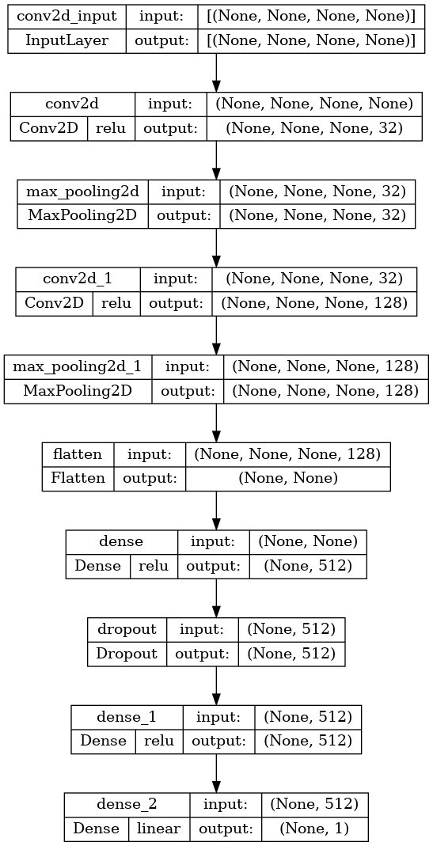
Model Architecture

Slide 4
Model Evaluation
The training process of a machine learning model involves using callbacks such as Early Stopping, Model Checkpoint, and Reduce Learning Rate on Plateau to configure the training and improve performance.
After training, it is important to evaluate the model's performance on a separate testing set using the evaluate method, which calculates various evaluation metrics to assess the accuracy of the model's predictions.
To perform real-time BMI predictions using webcam input, frames are continuously captured from the webcam, preprocessed, and passed through a trained model to predict the BMI. This enables real-time BMI estimation by combining computer vision techniques and a pre-trained model.

Slide 5
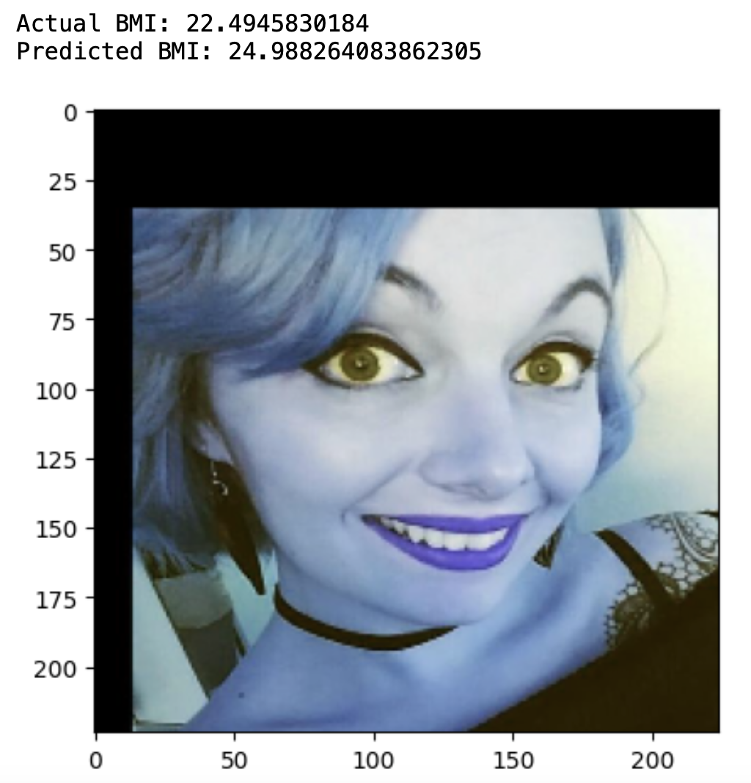
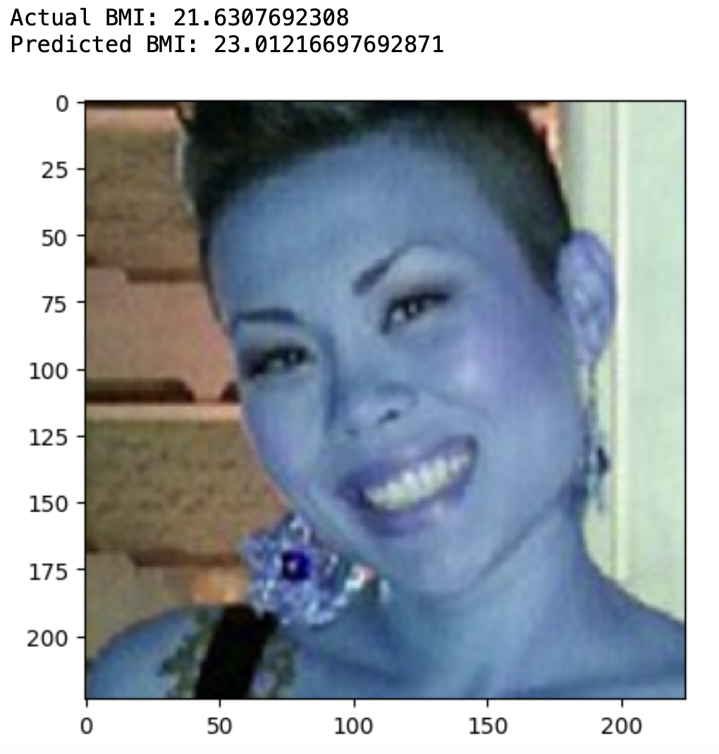
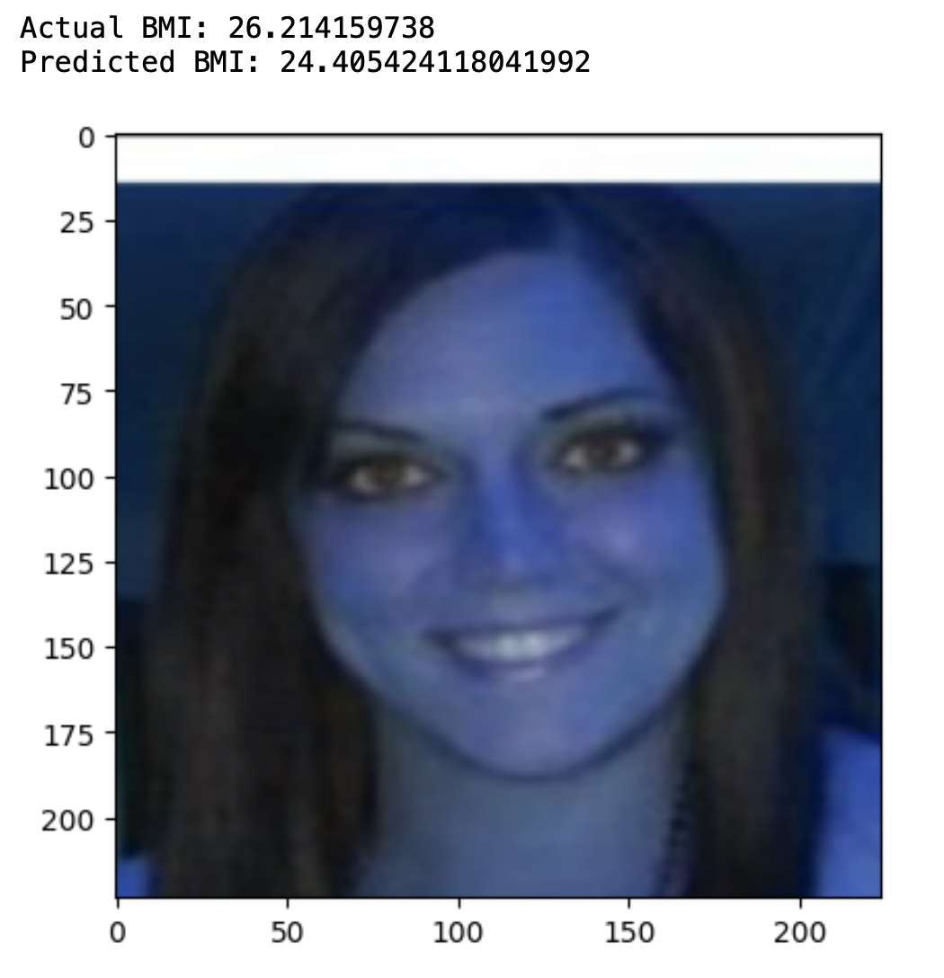
Results

Slide 6
Webcam Output
A web application is developed using Flask, which is a Python web framework known for its simplicity and versatility.
The face detection algorithm provided by OpenCV is utilized to identify faces in each frame of the video. These detected faces are then processed and prepared as input for the BMI prediction model.

Slide 7
Conclusion
In conclusion, this documentation outlines a process for developing a straightforward online API that uses a trained picture model to estimate a user's BMI in real-time. The objective is to develop a simple and user-friendly BMI prediction interface that accepts webcam input.
In order to improve the performance of the model, data augmentation techniques may also be used after loading and resizing the input photographs and dividing the data into training and testing sets.
By employing this technology, users can build a web API that predicts BMI in real-time based on webcam input, making it simple and accessible for users to keep track of their BMI.

Slide 8
Thank You

